Slide 1



API Gateway
Why and How by Example with Kong
Daniel Wagner
daniel_wagn3r

Slide 2
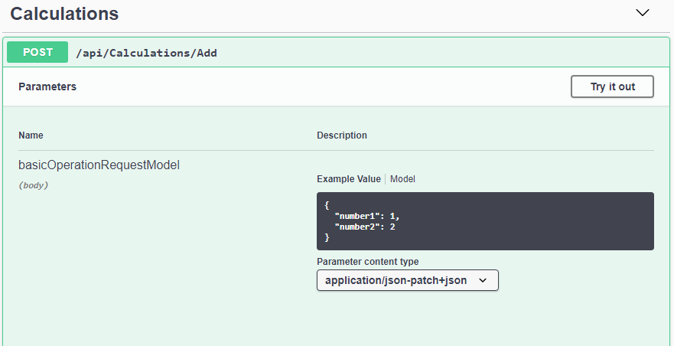
API – What?
Interface inside a component
public interface Calculator
{
int Add(int summand1, int summand2);
int Sub(int minuend, int subtrahend);
}
Interface provided by a component

Slide 3
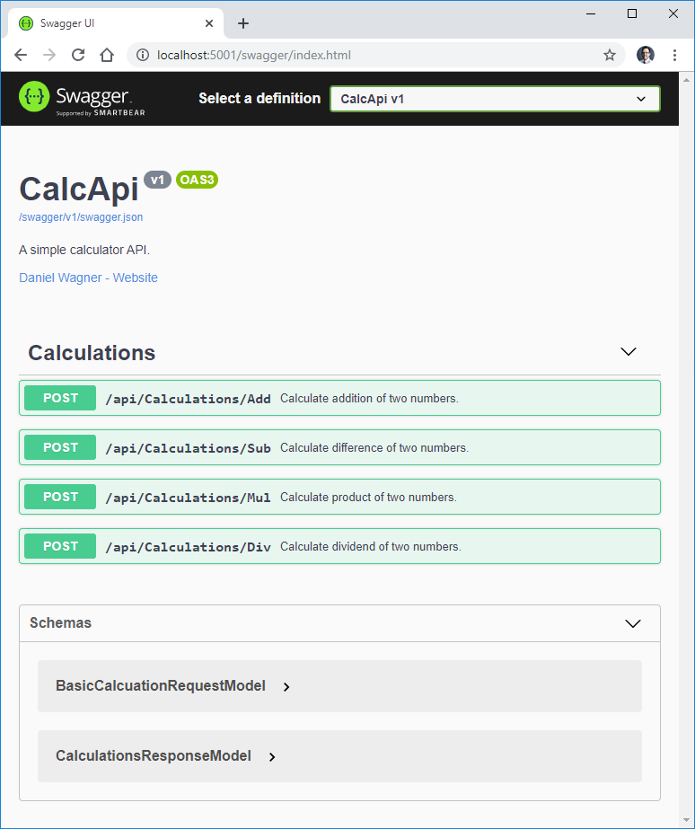
Excursus: Documentation
OpenAPI aka Swagger
Example .NET Core see
https://docs.microsoft.com/en-us/aspnet/core/tutorials/web-api-help-pages-using-swagger?view=aspnetcore-3.1
Notes:
https://docs.microsoft.com/en-us/aspnet/core/tutorials/web-api-help-pages-using-swagger?view=aspnetcore-3.1

Slide 4
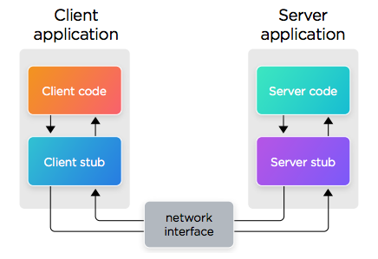
A view in the past
Pattern used by e.g.
RPC
CORBA
Java RMI
Quelle: https://dzone.com/articles/the-evolution-of-systems-integration

Slide 5
Example Java RMI
try {
Server obj = new Server();
Hello stub = (Hello) UnicastRemoteObject.exportObject(obj, 0);
// Bind the remote object's stub in the registry
Registry registry = LocateRegistry.getRegistry();
registry.bind("Hello", stub);
System.err.println("Server ready");
} catch (Exception e) {
System.err.println("Server exception: " + e.toString());
e.printStackTrace();
}
String host = (args.length < 1) ? null : args[0];
try {
Registry registry = LocateRegistry.getRegistry(host);
Hello stub = (Hello) registry.lookup("Hello");
String response = stub.sayHello();
System.out.println("response: " + response);
} catch (Exception e) {
System.err.println("Client exception: " + e.toString());
e.printStackTrace();
}

Slide 6



Basic operating principle
Backend APIs
Third Party APIs
Application
API Gateway

Slide 7
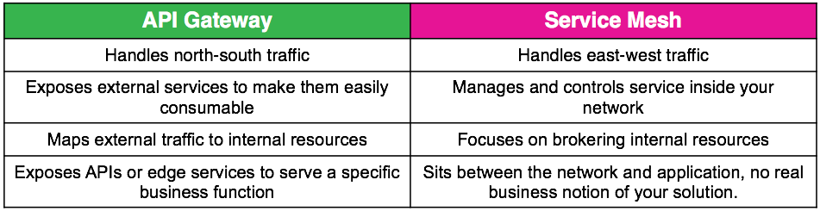
Choose your weapon
Quelle: https://dzone.com/articles/api-gateway-vs-service-mesh

Slide 8
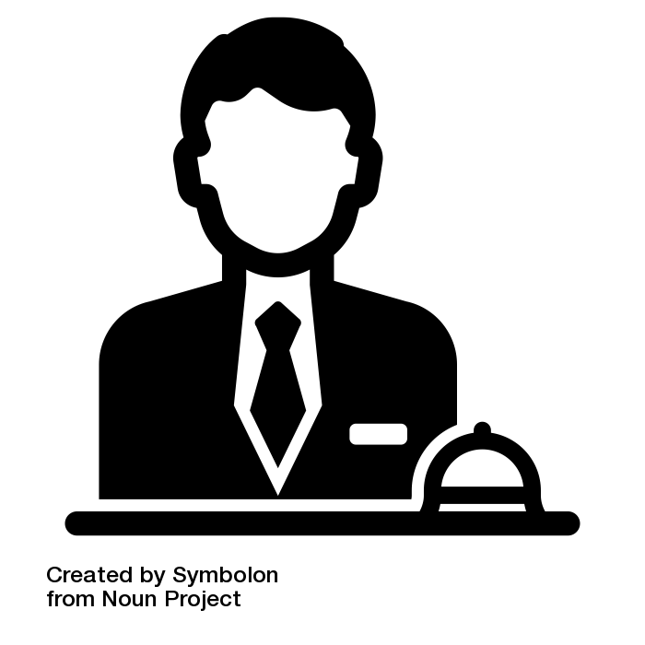
Concierge
API Gateway controlls traffic at the boundaries of a specific domain
Traffic can be inbound or outbound
Ext. Service
Consumer
Gateway
Domain
Service
Service
Source: concierge by Symbolon from the Noun Project

Slide 9
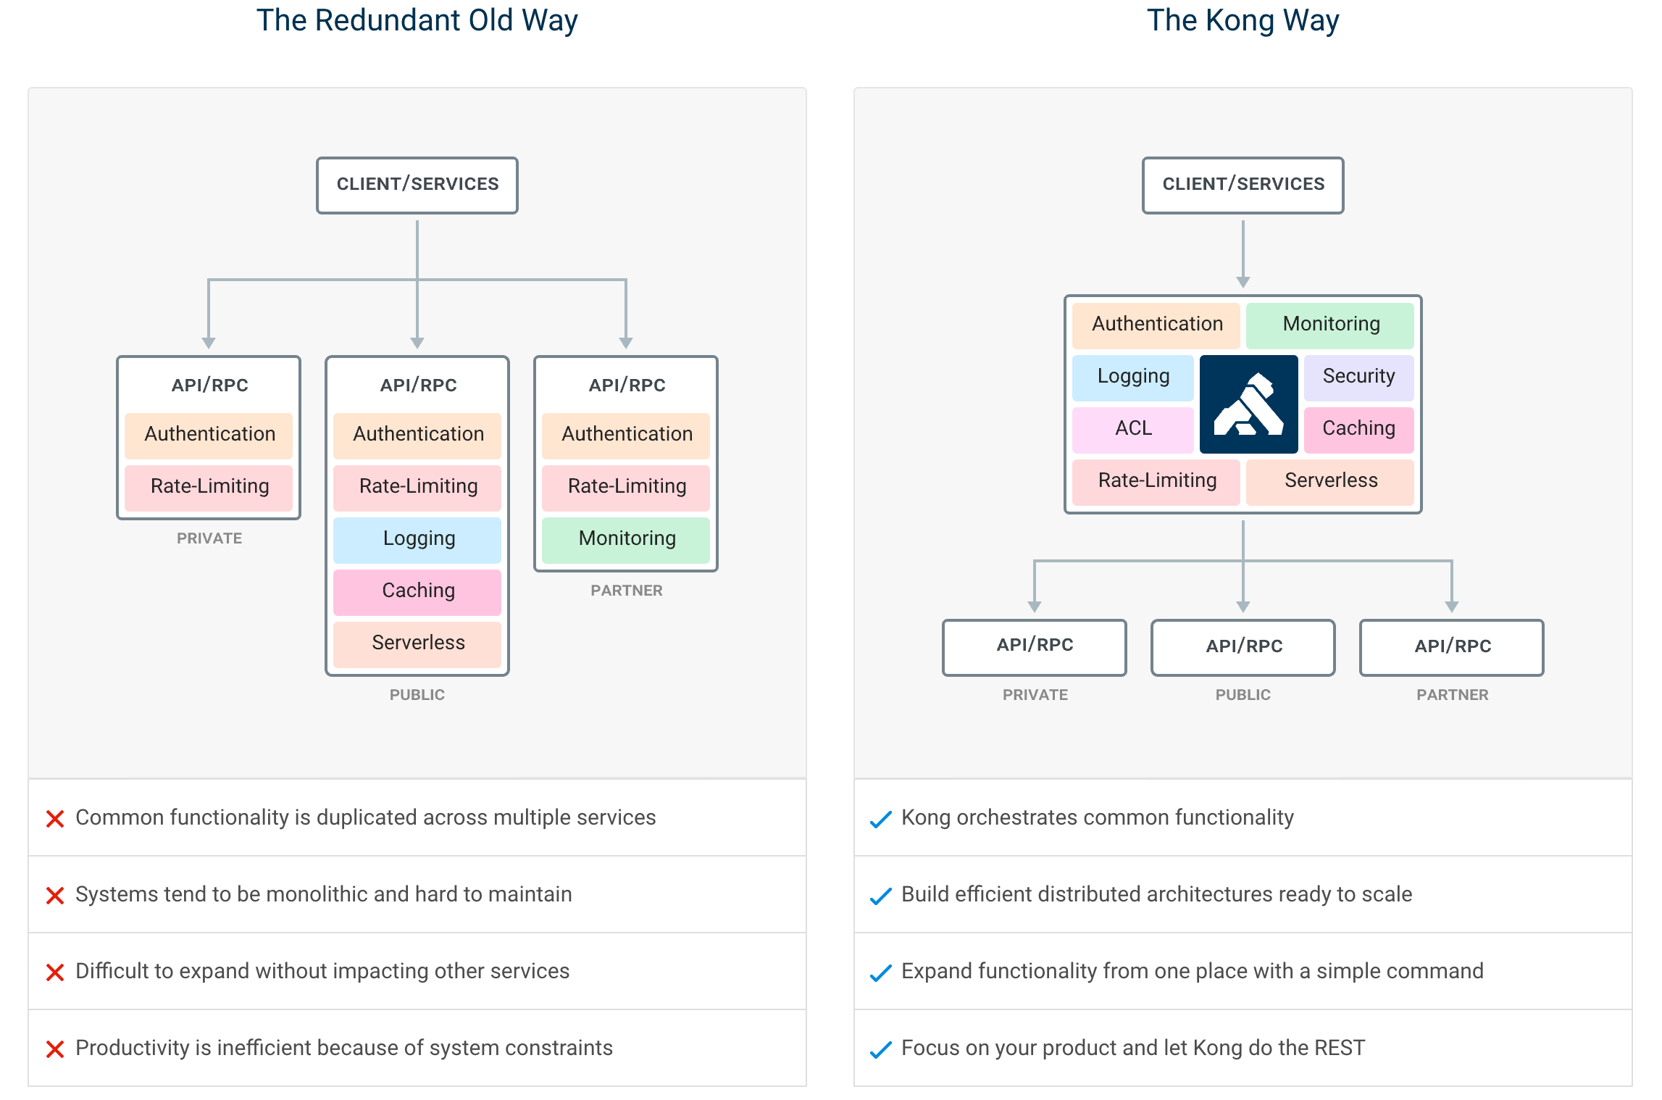
Traditional vs. Managed
Quelle: https://github.com/kong/kong

Slide 10

Limits and Anti-Pattern
Business Smart in Middle Ware
use facade
Complex programming in unsuitable environments
use micro services
Designs which are difficult to test and deploy
Siehe: https://www.thoughtworks.com/radar/platforms/overambitious-api-gateways
Notes:
Use Facade Pattern
Use Microservices
Eher nicht ESB oder Workflow Tool

Slide 11
Excursus: What about API Management?
Monetarization
Third party engagement
Legacy modernization
Decomposition of monoliths
Ensure security
Identify trends
Restrict and expand

Slide 12

Kong Gateway
open source API gateway
in fact it's fremium
smaller feature set
essentials are there
logging
monitoring
security
traffic control
...

Slide 13

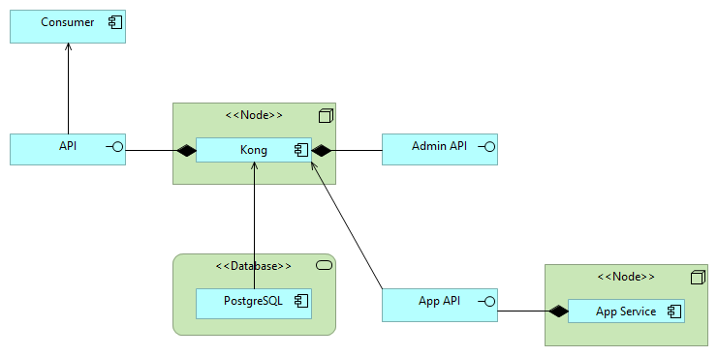
Deployment with Database
Siehe: https://www.archimatetool.com
Notes:
Link to Archi
Simple
VERBUND OpenShift Deployment

Slide 14
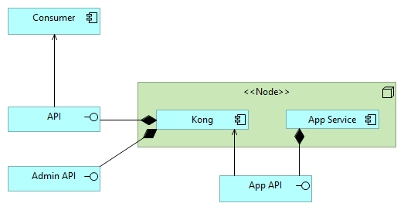
DB-less Mode
See: https://docs.konghq.com/1.4.x/db-less-and-declarative-config/
Notes:
https://docs.konghq.com/1.4.x/db-less-and-declarative-config/

Slide 15
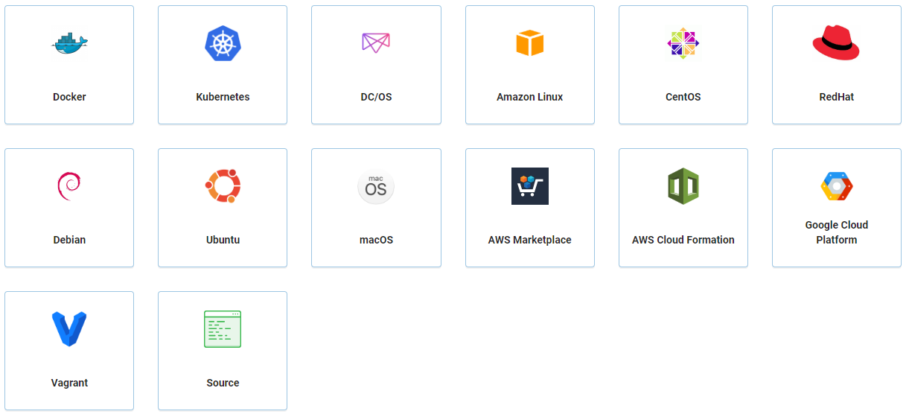
Installation
See: https://docs.konghq.com/install
Notes:
https://konghq.com/install/
Linux Distributions
Docker
Kubernetes
Azure
AWS
GCP
https://hub.docker.com/_/kong

Slide 16
Installation
Database backed Shared configuration Persisted and shared state
DB-less Mode Deklarative configuration Sidecar deployment

Slide 17

Hands-On
github.com/danielwagn3r/apimgmt-workshop

Slide 18
Clustering
Single Node „Cluster“
Multi Node „Cluster“
Configuration In-Memory
Update Polling
Entity Caching
Nodes eventually consistent
Load Balancer
Kong
Node
Node
Database
See: https://docs.konghq.com/1.4.x/clustering/
Notes:
https://docs.konghq.com/1.4.x/clustering/

Slide 19
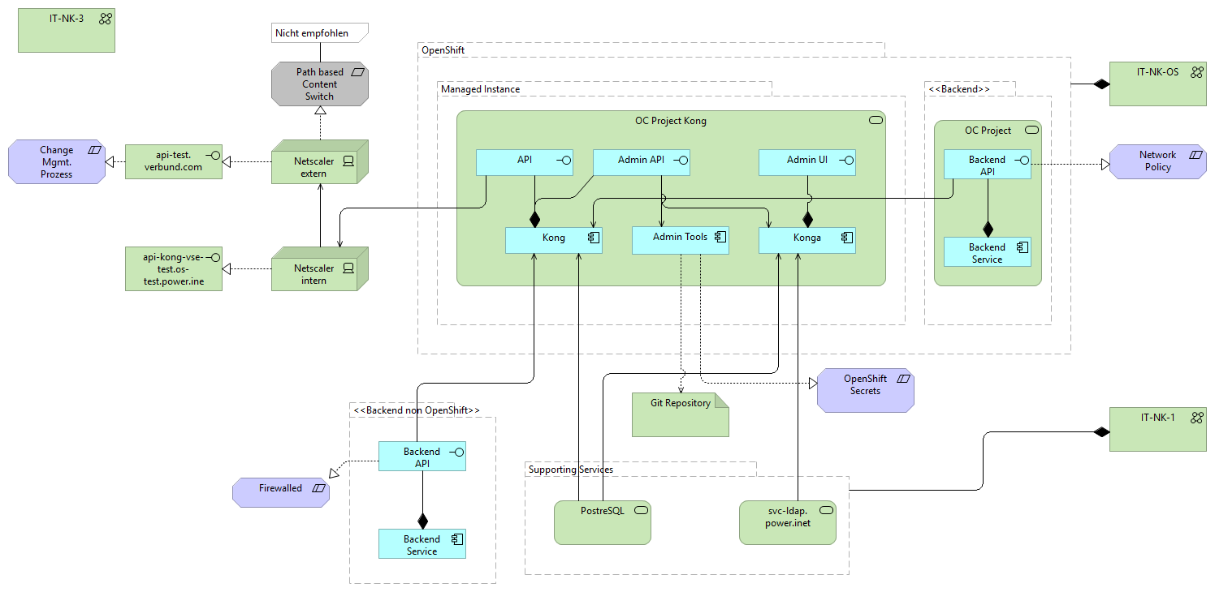
Real-world scenario

Slide 20
Concepts
Services
Routes
Consumers
Plugins
Upstreams
Targets
See: https://docs.konghq.com/1.4.x/admin-api/#service-object
Notes:
https://docs.konghq.com/1.4.x/admin-api/#service-object

Slide 21
Services
Abstractions of each of your own upstream services.
Examples:
billing
checkout
product
{
"name" : "calcapi-service",
"url" : "http://calc-api:80"
}
See: https://docs.konghq.com/1.4.x/admin-api/#service-object
Notes:
https://docs.konghq.com/1.4.x/admin-api/#service-object

Slide 22
Routes
Routes defines rules to match client requests
Routes are associated with a Service
{
"name" : "calcapi-route",
"hosts" : [
"calcapi.com"
]
}
See: https://docs.konghq.com/1.4.x/admin-api/#route-object
Notes:
https://docs.konghq.com/1.4.x/admin-api/#route-object

Slide 23

Tags
Tags are strings associated to entities.
Tags help to keep track of the configuration.
services:
- name: calcapi-service
url: http://calc-api:80
tags:
- demo routes:
- name: calcapi-route
service: calcapi-service
hosts: ["calcapi.com"]
tags:
- demo
See: https://docs.konghq.com/1.4.x/admin-api/#tags
Notes:
https://docs.konghq.com/1.4.x/admin-api/#tags

Slide 24
Consumers
A consumer / user of a service
Consumers have credentials
Basic
Keys
JWTs
OAuth2
Groups
consumers:
- username: principal
keyauth_credentials:
- key: secret
See: https://docs.konghq.com/1.4.x/admin-api/#consumer-object
Notes:
https://docs.konghq.com/1.4.x/admin-api/#consumer-object

Slide 25
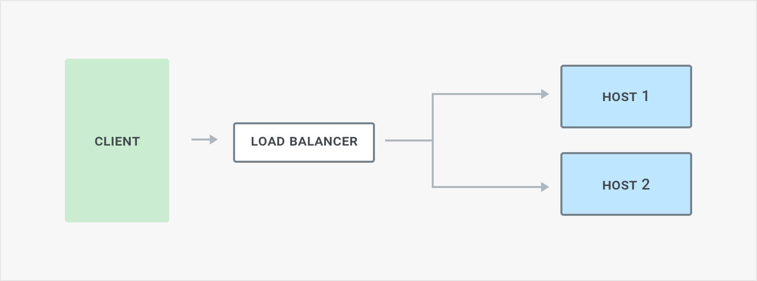
Healthchecks Basics

Slide 26
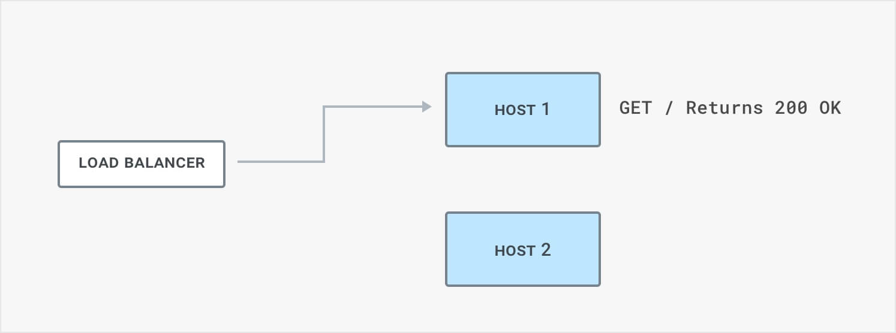
Active Health Check

Slide 27
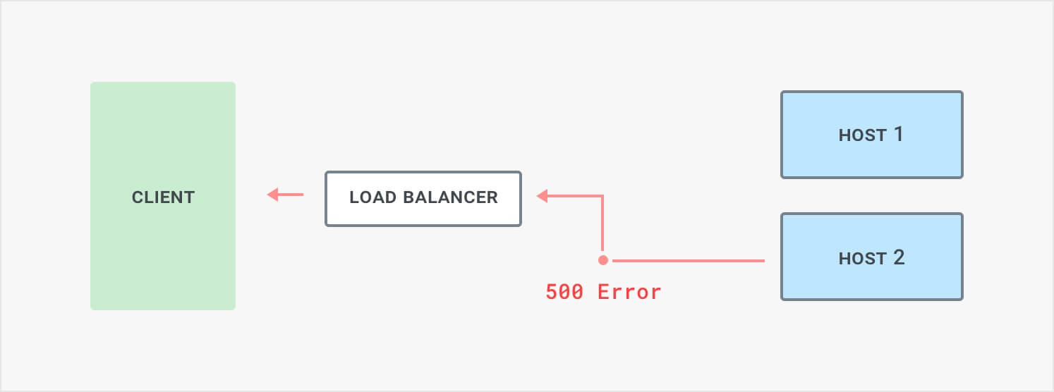
Circuit Breaker (1)

Slide 28
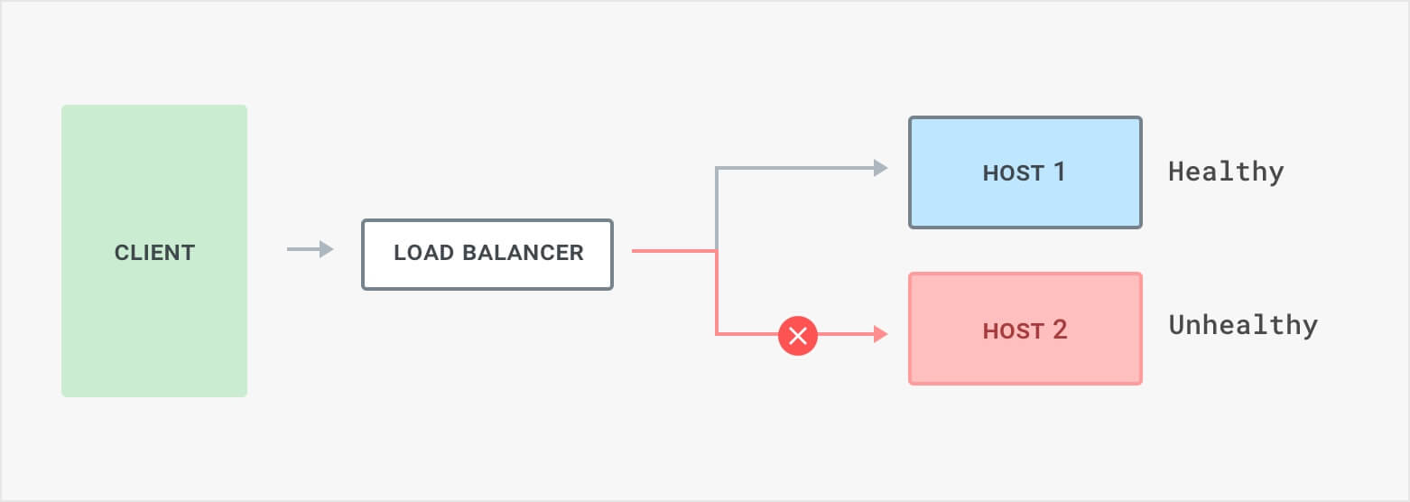
Circuit Breaker (2)

Slide 29
Upstreams
virtual hostname
load-balances requests to (multiple) services (targets)
includes health checker
disables targets based on inability to serve requests
{
"name": "calcapi.v1.service"
}
See: https://docs.konghq.com/1.4.x/admin-api/#upstream-object
Notes:
https://docs.konghq.com/1.4.x/admin-api/#upstream-object

Slide 30
Targets
IP-adress or hostname w/ port identifying an instance of a backend service
Dynamic list with weights per upstream
Cannot be deleted
{
"target" : "calc-api:80",
"weight": 100
}
See: https://docs.konghq.com/1.4.x/admin-api/#target-object
Notes:
https://docs.konghq.com/1.4.x/admin-api/#target-object

Slide 31
Plugins
Plugins are executed during HTTP request/response lifecycle
Plugins are bound to services, routes and/or consumers
Plugins are developed in Lua
{
"name": "ip-restriction",
"config": {
"whitelist": [
"172.18.0.0/16"
]
},
"consumer": null,
"protocols": [
"http",
"https"
],
"route": {
"id": "5ff018a3-2a25-567e-8c74-1805c4029fbd"
},
"service": null
}
See: https://docs.konghq.com/1.4.x/admin-api/#plugin-object
Notes:
https://docs.konghq.com/1.4.x/admin-api/#plugin-object
When adding a Plugin Configuration to a Service, every request made by a client to that Service will run said Plugin. If a Plugin needs to be tuned to different values for some specific Consumers, you can do so by creating a separate plugin instance that specifies both the Service and the Consumer, through the service and consumer fields.

Slide 32





Service Design
Operations
Development
Networking
Security
Consumers
See: Icons made by mynamepong from www.flaticon.com
Notes:
https://www.flaticon.com/packs/software-development

Slide 33
Logging and Monitoring
Health Routes provided to retrieve node status
Plugins for integration, e.g.
Prometheus
TCP/UDP Log
HTTP Log
{
"database": {
"reachable": true
},
"server": {
"connections_accepted": 162,
"connections_active": 1,
"connections_handled": 162,
"connections_reading": 0,
"connections_waiting": 0,
"connections_writing": 1,
"total_requests": 162
}
}
See: https://docs.konghq.com/1.4.x/admin-api/#health-routes
Notes:
https://docs.konghq.com/1.4.x/admin-api/#health-routes

Slide 34

What else?
Gateways
Ocelot https://threemammals.com/ocelot
Amazon API Gateway
Azure API Management
Service Mesh
Consul https://consul.io/
Envoy https://envoyproxy.io/
Istio https://istio.io/
Linkerd https://linkerd.io/
See: https://www.thoughtworks.com/radar/techniques/service-mesh

Slide 35
Slides & Hands-On
github.com/danielwagn3r/apimgmt-workshop

Slide 36


